Slide 1
Learning intentions and success criteria
I am learning…
I can…
About computer structure
About the purpose of basic computer architecture components
Describe what the parts of a computer are used for
Explain the need for interpreters and compilers

Slide 2

Computer Structure
N5 – Computer Systems

Slide 3
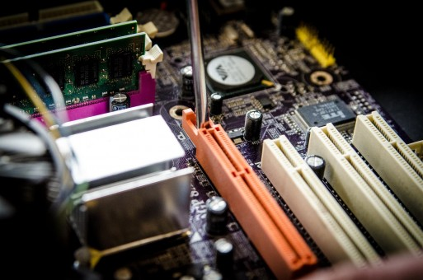
Computer Architecture
All computers have basic components that are needed to allow them to run:
Input, Output and Backing Storage Devices
Processor – Registers, ALU, and Control Unit
Memory – RAM and ROM
Buses – Data Bus and Address Bus
3

Slide 4
Computer Architecture
Processor
Input Devices
Output Devices
RAM
ROM
Backing Storage
4

Slide 5
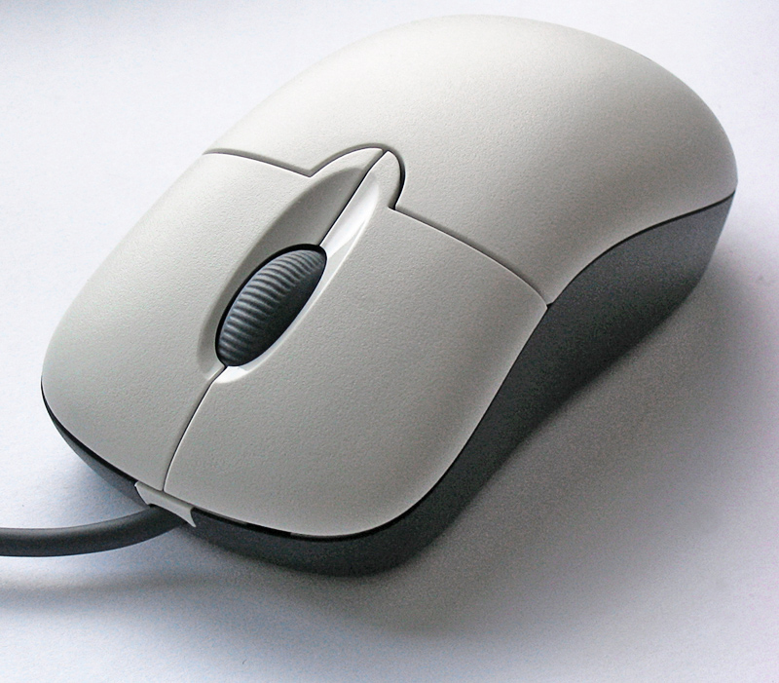
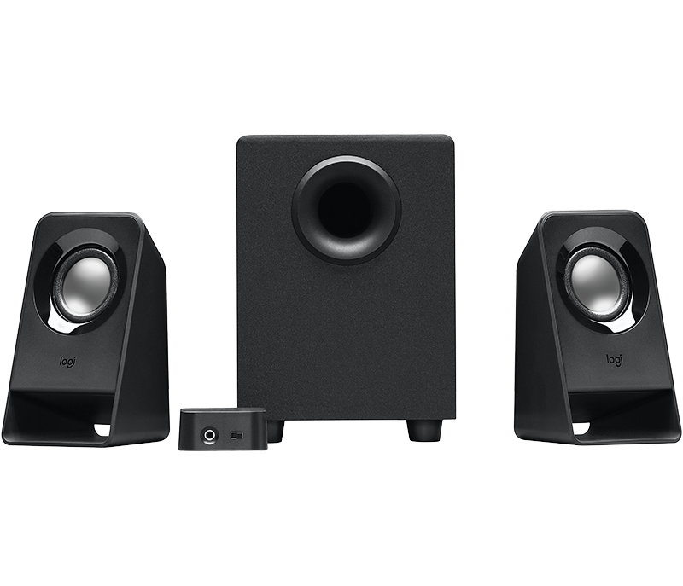
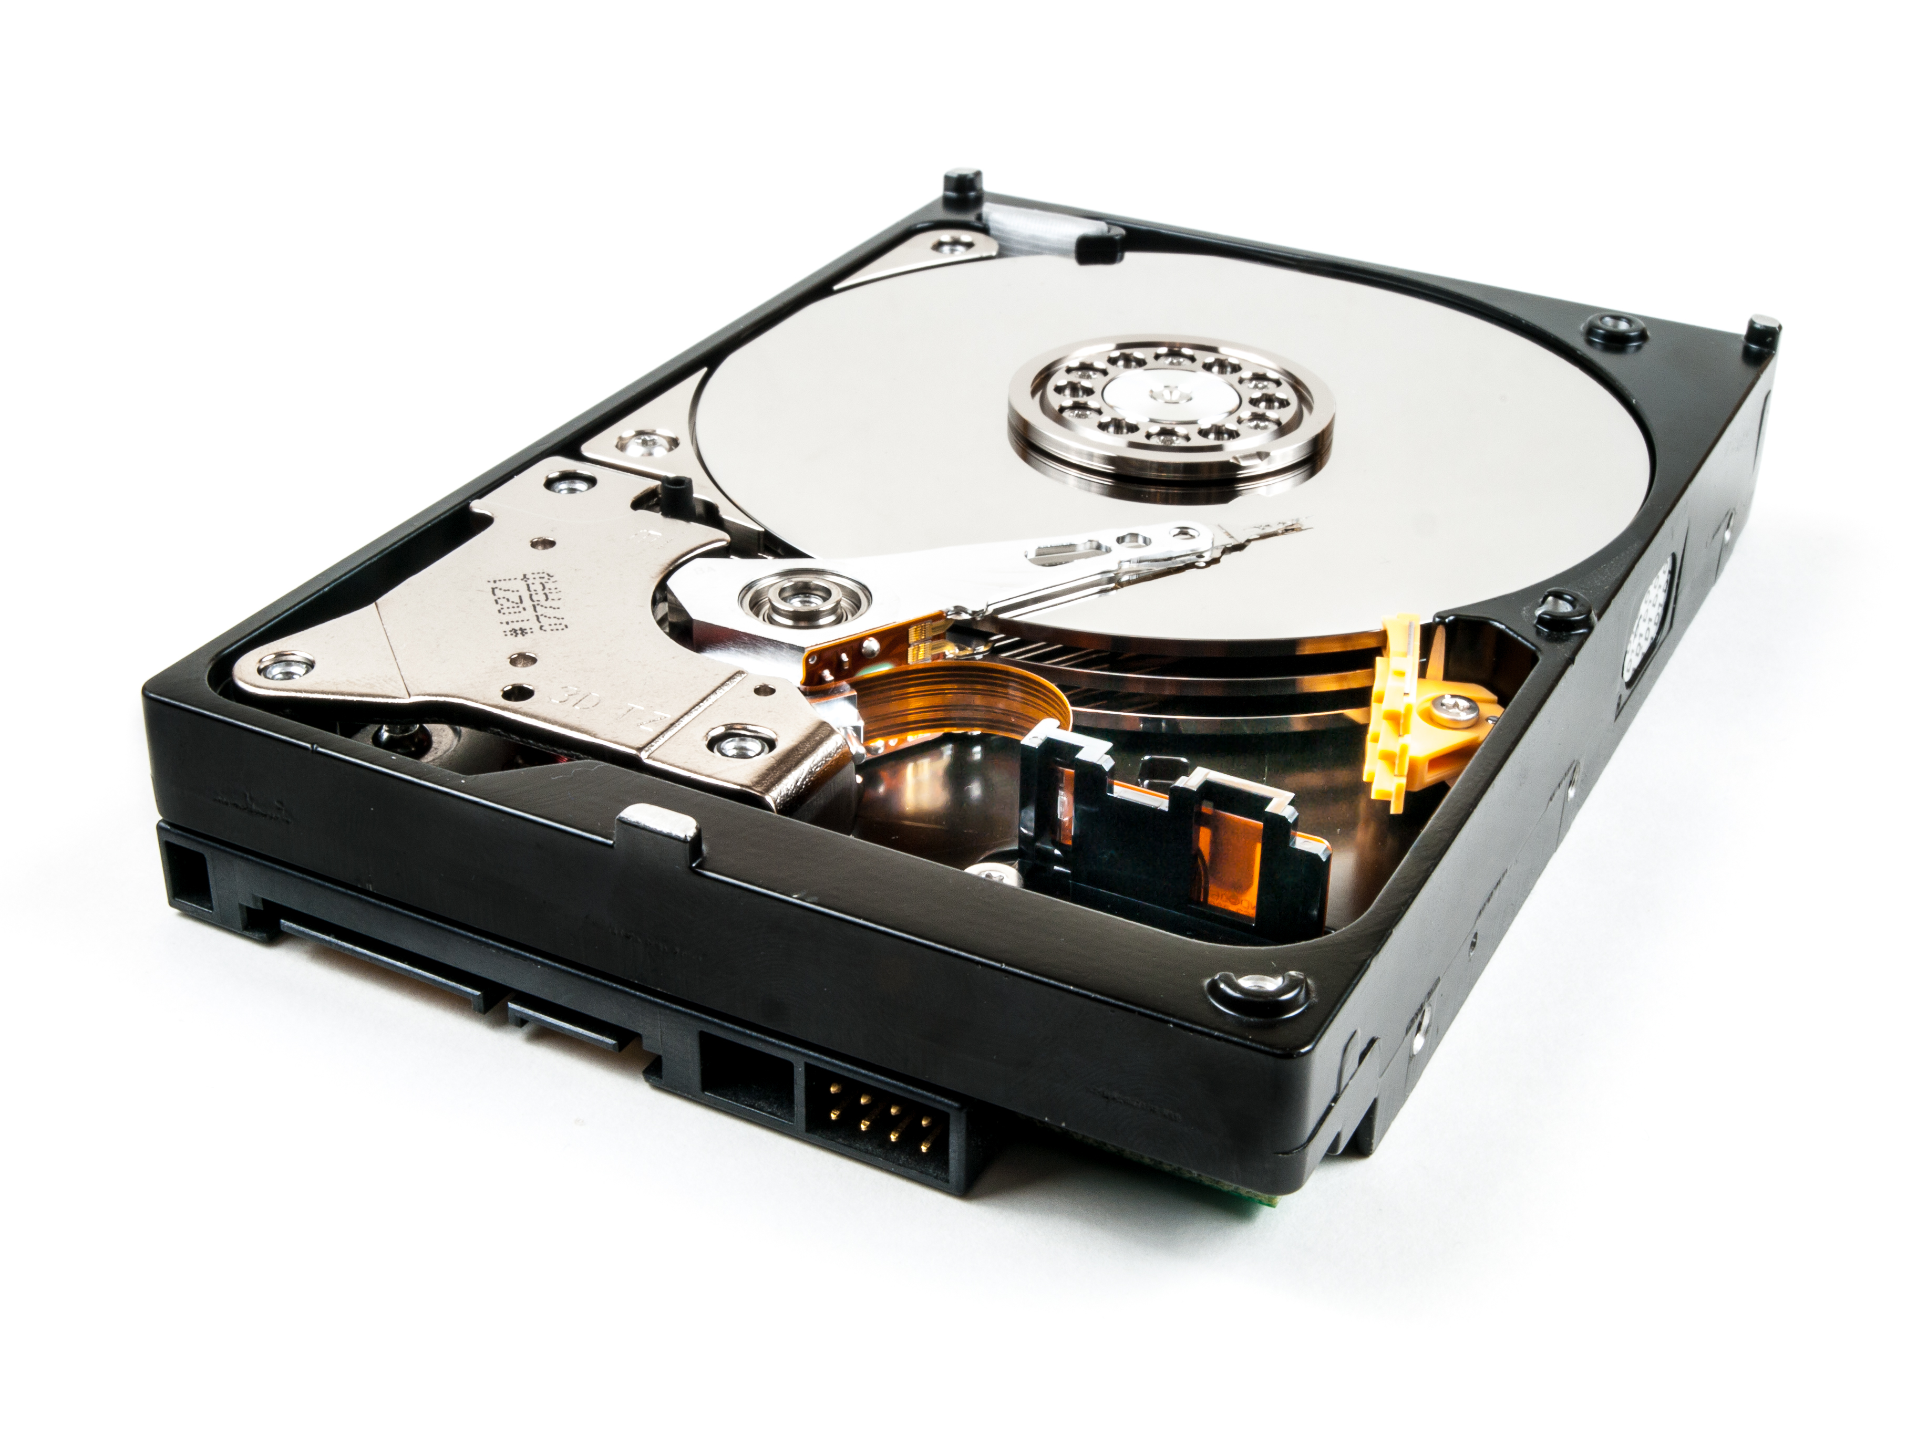
Devices
Input Devices
Devices which enter information into the computer
E.g. mouse, keyboard, microphone, touchscreen
Output Devices
Devices which give the user information
E.g. monitor, speakers, headphones, printer
Backing Storage Devices
Devices which store data and programs
E.g. Hard-drive, SSD, USB Stick, Cloud Storage
5

Slide 6
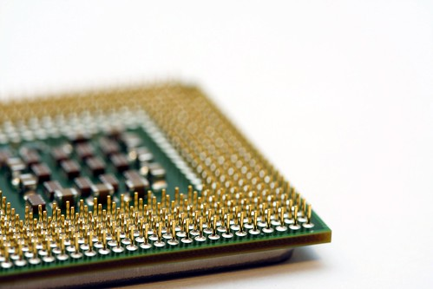
Processor
The processor is the ‘brain’ of the computer and carries out the operations the computer performs:
A computer requires instructions to be able to do anything. It requires instructions to start up, load programs, to save etc.
Instructions are fetched from RAM by the processor where they are decoded and executed. Processors can carry out billions of instructions every second.
The processor is the part of the computer system that handles the instructions used to ensure that hardware and software respond as expected.
The processor is responsible for fetching, decoding and executing instructions.
6

Slide 7
Parts of a Processor
Registers
Small, temporary storage locations for data being used by the processor
Any data being processed RIGHT NOW- nothing else
Arithmetic and Logic Unit (ALU)
Performs calculations (+ - / * ^)
In charge of logic (AND, OR, NOT)
Control Unit
Controls other parts of the processor
Fetches and executes instructions from memory (RAM/ROM)
In charge of the timings of instructions to make sure everything runs in the right order
7

Slide 8
Memory
Main Memory is where files and programs are stored temporarily whilst the processor is using them.
Random Access Memory (RAM)
Stores programs when they are being used
Is volitile, which means when the PC is off, all memory is lost
The more RAM a computer has, the more data and programs it can store/run simultaneously
Read-Only Memory (ROM)
Permanent, cannot be overwritten
Holds memory even when PC is off
Stores instructions needed for the computer to run and start the operating system
8

Slide 9
Memory Addresses
When you open a document that you have saved on your hard drive it is transferred into RAM:
Every item that is saved in memory has a unique location so that it can be opened and found again.
When it is saved it is given a unique address.
This is known as addressability and is how the computer identifies different memory locations.
9

Slide 10
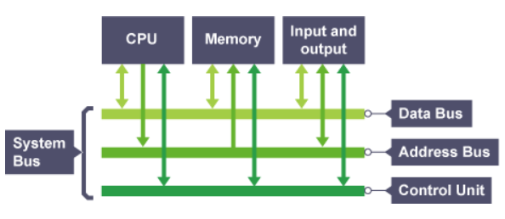
Buses
Buses are the sets of wires which connect the CPU to the memory and peripherals.
10

Slide 11
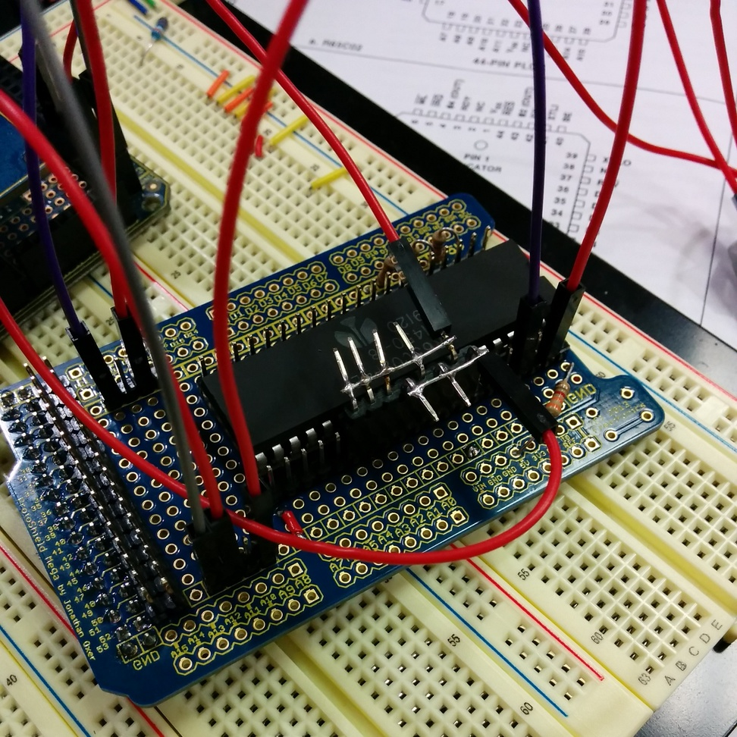
Data Bus
The data bus is bi-directional – data can flow both ways:
Its purpose is to transport data both to and from memory and the processor.
Data is placed on the data bus and then transferred either to a memory location or to the processor to be executed.
11

Slide 12
Address Bus
The address bus pinpoints a location in memory:
It is a uni-directional bus, which means it can only go one way, from the processor to the memory location.
The purpose of the address bus is to hold the memory location that is to be accessed:
i.e. If writing data to memory the address bus holds the location to be written into
i.e. If reading data the address bus will hold the location of where the data is being stored
12

Slide 13
Computer Architecture
Processor
Input Devices
Output Devices
RAM
ROM
Backing Storage
13

Slide 14
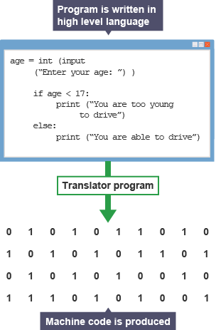
Translators
The CPU can’t understand lines of code that humans make:
CPUs only understand binary – 1s and 0s
Code needs to be turned into binary instructions
Translators can either be a:
Compiler
Interpreter
14

Slide 15
Compilers and Interpreters
Compilers
Translates the program from source code into object code
Object code is held in a new file which can be executed by the CPU
Translates the whole program first
Interpreters
Translates source code directly into machine code
The translator runs throughout this translation and execution process
Each line of source code is translated to machine code one at a time
Each line of code is executed as soon as it is translated
15

Slide 16
Learning intentions and success criteria
I am learning…
I can…
About computer structure
About the purpose of basic computer architecture components
Describe what the parts of a computer are used for
Explain the need for interpreters and compilers

